Slide 1
Lecture 8
Physics of Welding Arc IV

Slide 2
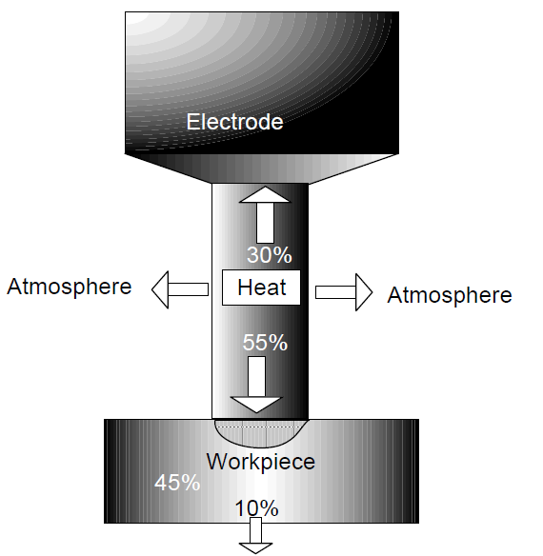

Arc Efficiency
-Part of heat generated by arc (I x V) is used for melting purpose to produce weld joint and remaining is lost in various ways namely through conduction to base metal, by convention and radiation to surrounding
For heating the electrode
Lost
Heat used for melting

Slide 3
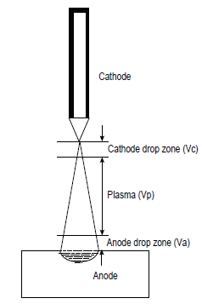
Arc Efficiency
-The heat generation on the work piece side depends on the polarity in case of DC welding while it is equally distributed in work piece and electrode side incase of AC welding
-The power of the arc (P ) =
= (Vc + Vp + Va) X I …………………….5.1
-In case of DCEN polarity(i.e.Electrode Negt.)
, high heat generation at work piece facilitates
melting of base metal to develop a weld joint
of thick plates.

Slide 4
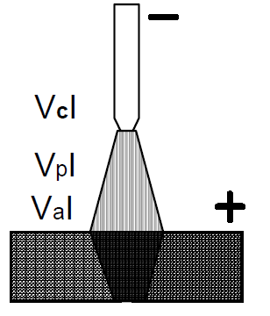
Reasons Behind Variation In Arc Efficiency Of Different Arc Welding Processes
-Arc welding efficiency =Arc heat used for melting /Total heat of the arc
-For non-consumable arc welding processes(with DCEN polarity )such as GTAW, PAW, Laser and electron beam welding processes where filler metal is not commonly used. Heat generated at the anode only is used for melting of the base material
-So the Arc efficiency =
Heat generated at anode / Total heat of the arc

Slide 5
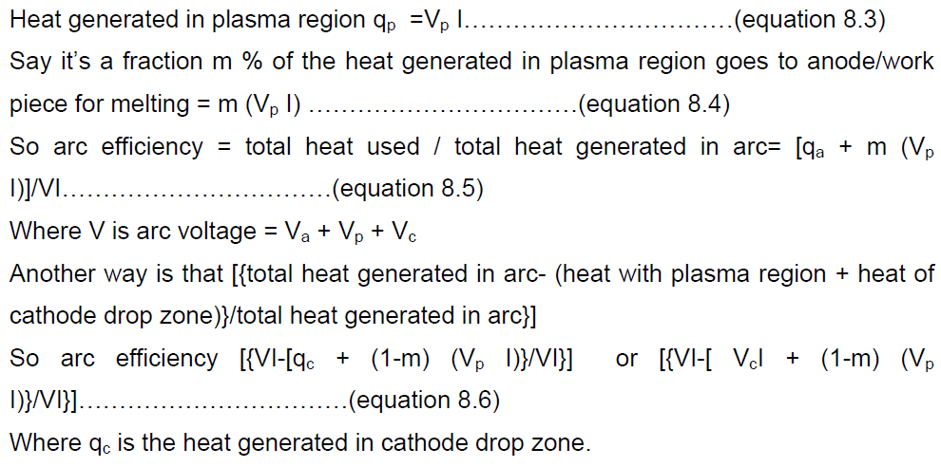

Determination of arc efficiency
qa=heat generated at anode =Va * I

Slide 6
Reasons Behind Variation In Arc Efficiency Of Different Arc Welding Processes
-For consumable arc welding processes (SMAW, SAW, GMAW).Heat generated both at cathode and anode used for melting of electrode and base metal.
-So Arc efficiency =
Heat generated at both cathode and anode / Total heat of the arc.
-Heat generated is more effectively used because of reduced heat losses to surrounding as weld pool is covered by molten flux and slag.
-Non consumable electrode offer's lower arc efficiency (21-48%) while consumable electrode offer's (66-99%) ???? Why

Slide 7
Metal Transfer
-Metal transfer refers to the transfer of molten metal from the tip of a consumable electrode to the weld pool
-It is control the handling of molten metal, slag and spattering.
-Some of the arc welding parameters affect the mode of
metal transfer for a given power (welding current and voltage)are:
1.Shielding gas,
2.Composition of the electrode,
3.Diameter and extension of the electrodes
-Four modes of metal transfer are observed consumable arc welding:
1.Short Circuit Transfer
2.Globular Transfer
3.Spray Transfer
4.Dip Transfer

Slide 8
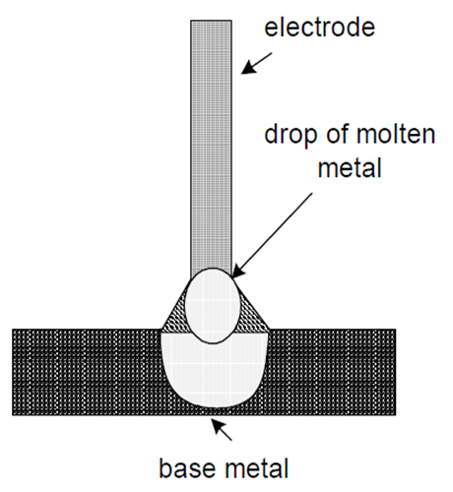
Short Circuit Transfer
-When welding current is very low (but high enough to have stable arc )and arc gap is small molten metal droplet grows slowly at the tip of the electrode and then when drop touches weld pool, short-circuiting takes place welding current flowing through the droplet to the weld pool increases suddenly that results in increasing the heat generation that makes the molten metal of droplet thinner (low surface tension)..

Slide 9
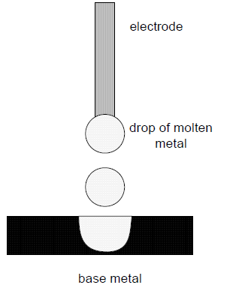
Globular Transfer
-It takes place when welding current is low (but > short circuit transfer) and arc gap is large enough so molten metal droplet attains large size enough larger than the electrode diameter and gravitational force on drop (due to its own weight)exceeds any holding forces at the tip of electrode.

Slide 10
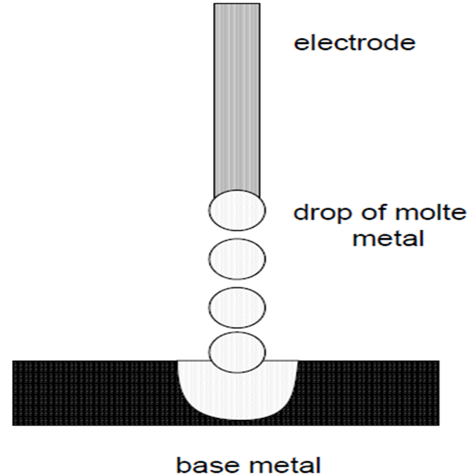
Spray Transfer
-It takes place when welding current density is higher than that is required for globular transfer.
-High welding current density results in high melting rate greater pinch force and lowers
the surface tension force
-Therefore droplets are formed
rapidly and de attached even when
they are of very small in size.

Slide 11
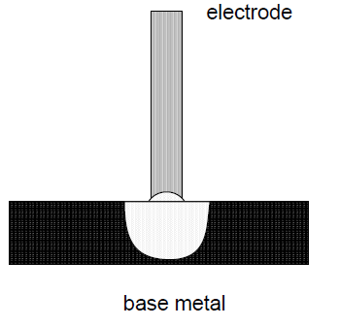
Dip Transfer
-It is observed when welding current is very low and feed rate is high thus electrode is short-circuited with weld pool, which leads to the melting of electrode and transfer of molten drop.
-Dip transfer is similar to that of short circuit metal transfer and many times the two are used interchangeably.

Slide 12
Melting Rate
-In consumable arc welding processes, weld metal deposition rate is governed by the rate at which electrode is melted during welding.
-Melting of the electrode needs the sensible and latent heat, which is the heat generated at anode (I.Va), cathode (I.Vc) and plasma zone (I.Vp).
-In case of DCEN polarity, heat generated in anode drop region and plasma region do not influence melting of electrode tip these two regions (anode and plasma).
-Thus melting rate of electrode depends on the heat generated by
cathode reaction and
b) electrical resistance heating
thus melting rat is given by following equation:

Slide 13
Melting Rate
where a & b are constant {(independent of electrode extension (L) and welding current (I)}
-Value of constant “a” depends on ionization potential of electrode material, polarity, composition of electrode and anode/cathode voltage drops
-Value of constant “b” depends on electrode diameters and resistivity of electrode metal).

Slide 14
Melting Rate
-Melting rate equation suggests that first factor (a X I) due to heat generated by anode/cathode reaction and second factor (b X L X I2) du to heat generated by electrical resistance heating.
-Melting rate is mainly governed by the first factor when welding current is low, electrode diameter is large and extension is small,
-Melting rate is mainly governed by the second factor when welding current in high, electrode diameter is small, extension is large and electrical resistivity of electrode metal is high.

Slide 15
Factors Limiting the Melting Rate
-Difference in values of constant a and b and welding parameters lead to the variation in melting rate of the electrode in case of different welding processes.
-To increase the melting rate, welding current for a specific welding process can be increased up to a limit.
-The upper limit of welding current is influenced by two factors :
1.Extent over heating of electrode caused by electrical resistance heating and so related thermal degradation of the electrode and
2.Required mode of metal transfer for smooth deposition of weld metal with minimum spatter.

Slide 16
Factors Limiting the Melting Rate
-For example
-Upper level of current, in MIG/SAW, is limited by appearance of rotational spray transfer.
-Upper limit of current in case of SMAW is dictated by thermal composition of the electrode coating and that in case of GTAW is determined by thermal damage to tungsten electrode.
-Wile minimum welding current , in MIG/SAW is determined by the current level at which short circuit metal transfer starts and
-Lower level of current in case of GTAW is determined by arc stability, penetration, proper placement of the weld metal and control over the weld pool in vertical welding .

